Slide 1

STOCKER
Niravra Kar
Parakh Mahajan
Kaustubh Chaudhari
Komal Suthar
Piyush Sharma

Slide 2
Business Goals
Creating a large user base by providing state of the art technologies and convenience
Collecting interest on the cash left in brokerage account and providing advanced features as a part of premium account
Brand Identity
One stop solution for stocks and digital currencies
You can invest for securing your future without having a solid understanding of how the stock market works using our advanced AI neural engine
Something of interest for every type of investors
Success Metrics
How normal people feel about the ease of using this product
The number of users joined the site within an year
Reaching break-even within an year
How many people took the help of advanced investing features and joined the premium list
Project Objective

Slide 3
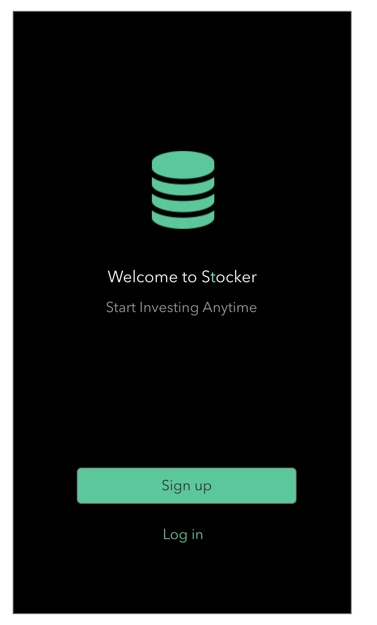
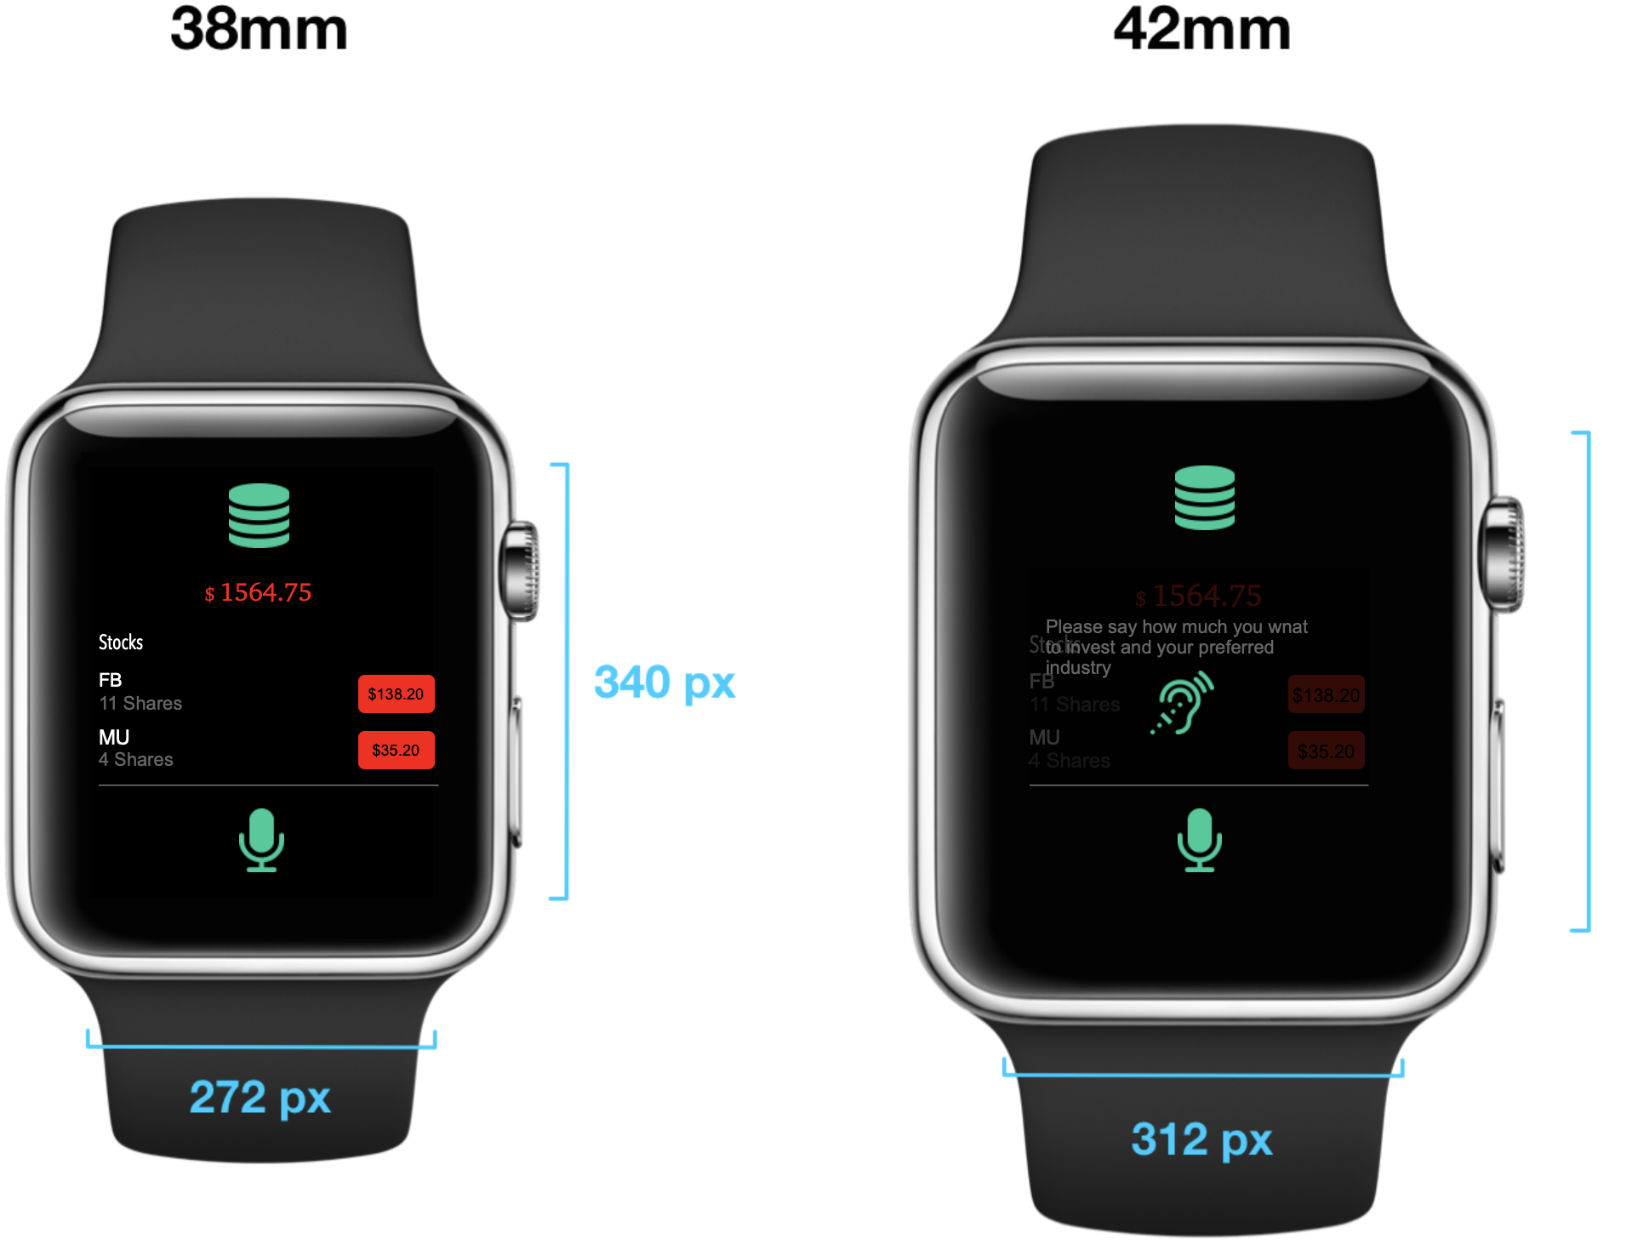
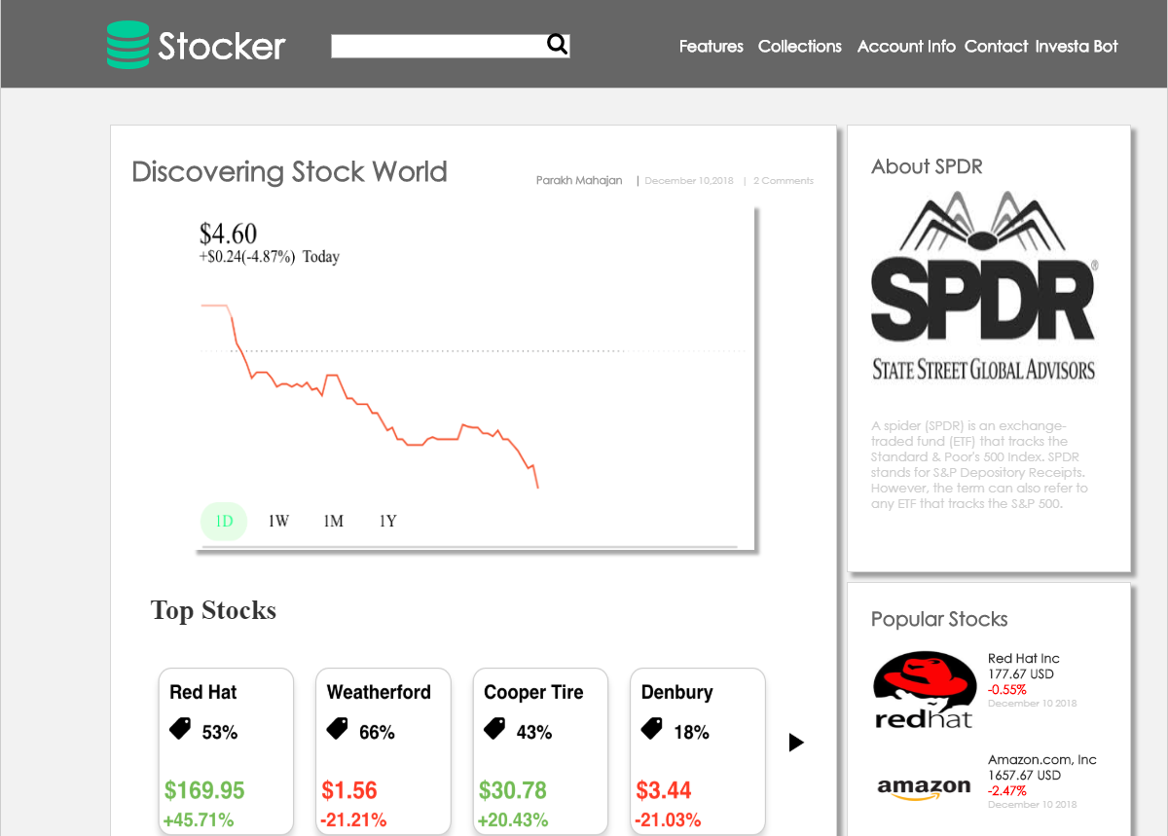
OUR PRODUCTS

Slide 4
Skeleton Plane
The skeleton plane deﬁnes what form of product functionality will take.
On the functionality side, we deﬁne the skeleton through interface design—the familiar realm of buttons, ﬁelds, and other interface components.
Navigation design is the specialized form of interface design tailored to presenting information spaces. Finally, crossing both sides, we have information design, the presentation of information for effective communication.
In our model we are specifying interface design by using various Buttons, Logo, Text, Dropdown list which are navigating to the appropriate pages.
Defining the Local navigation design in the according the application flow

Slide 5
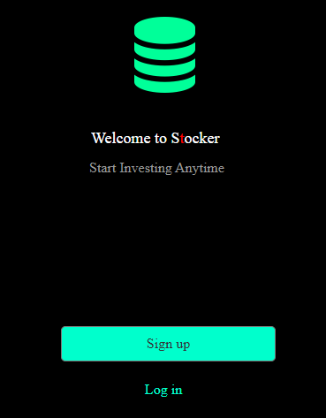
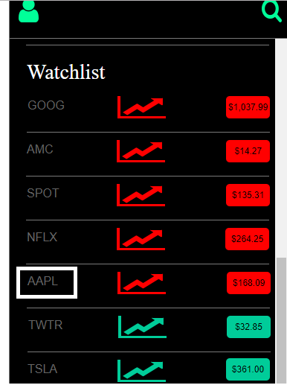
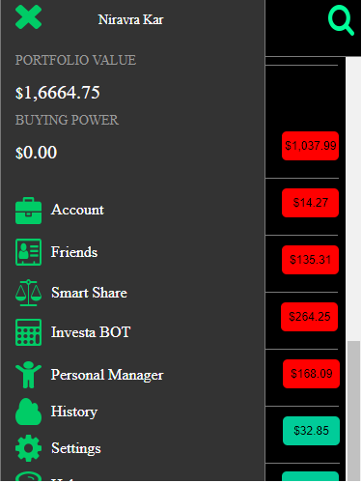
Interface Design
On Text Click
On Icon Click
On Button Click

Slide 6
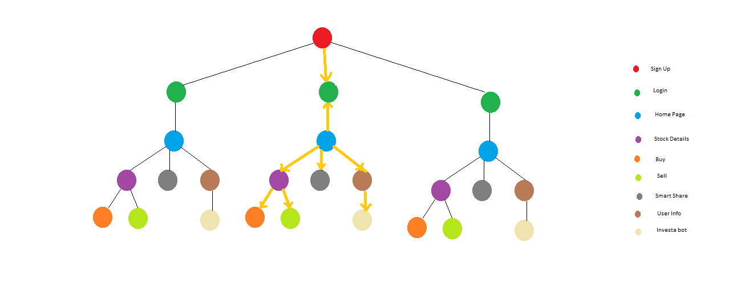
Local Navigation

Slide 7
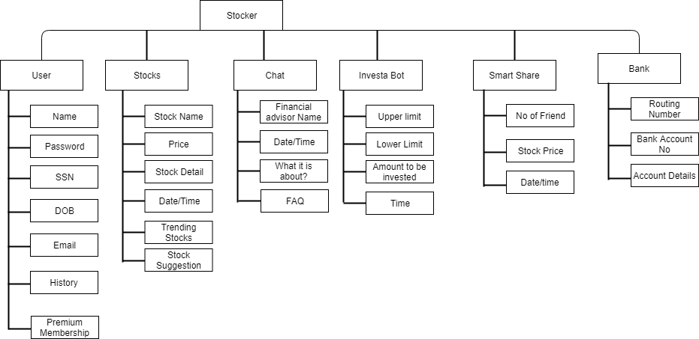
Classifying Information Design

Slide 8
Surface Plane
SENSORY DESIGN:
Contrast color combinations
Internal Consistency
Brand Identity, Buttons, Icons, Tables

Slide 9
UX PRINCIPLES
Follow user’s mental model
Meet user requirements
Consistent design
Provided tool-tip to enable easy understanding of terms

Slide 10

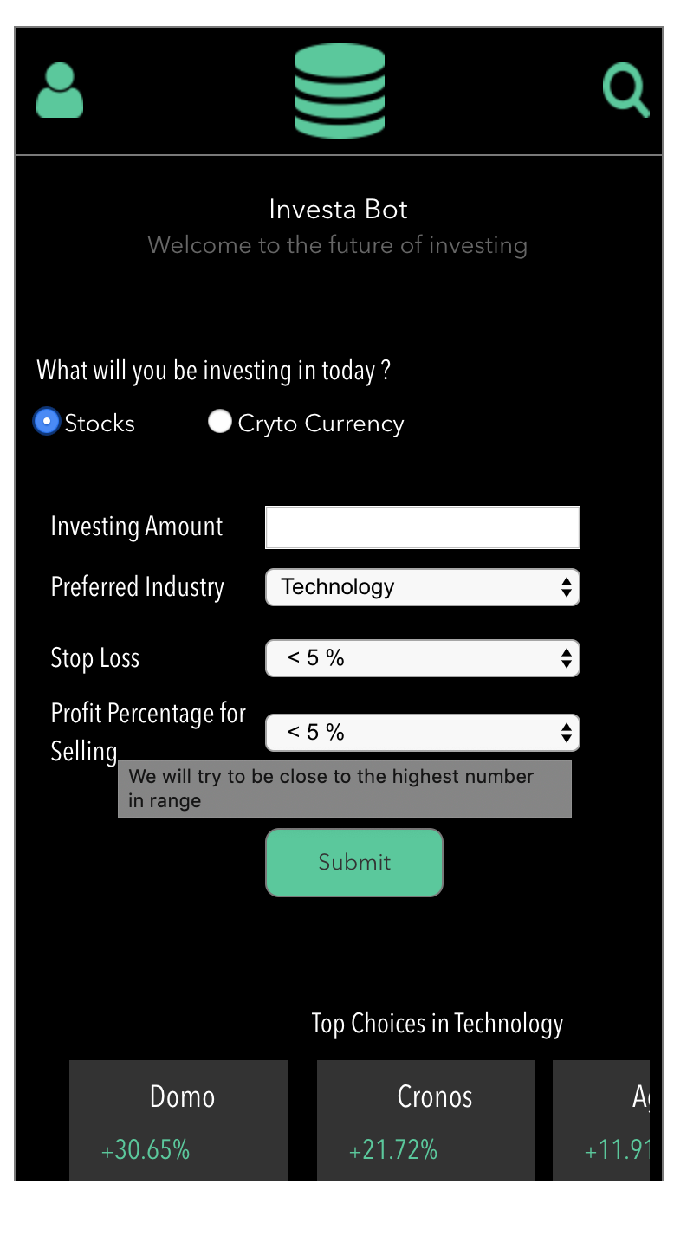

Slide 11
User Research Methods
Email Survey
Concept Testing
Moderated & unmoderated remote testing
Focus Groups
Usability Benchmarking

Slide 12
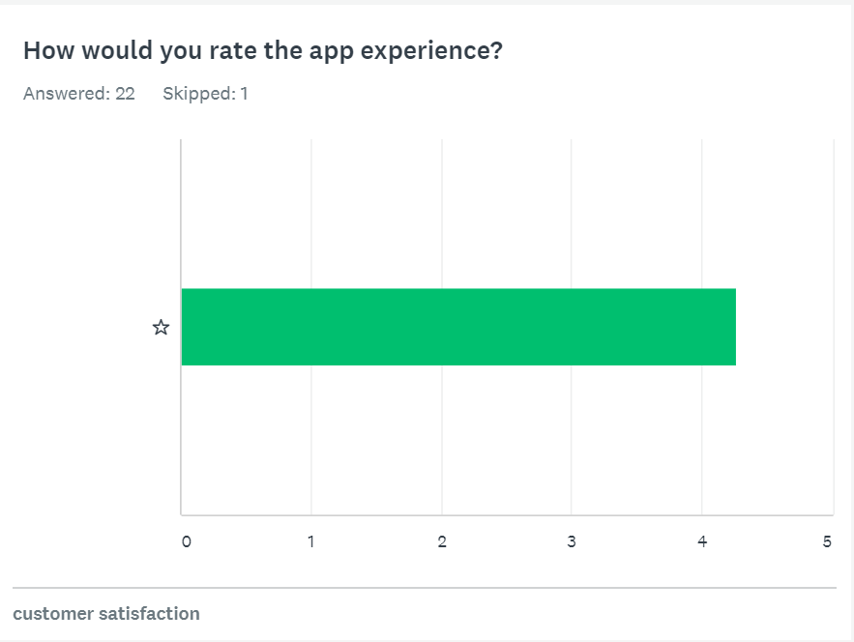
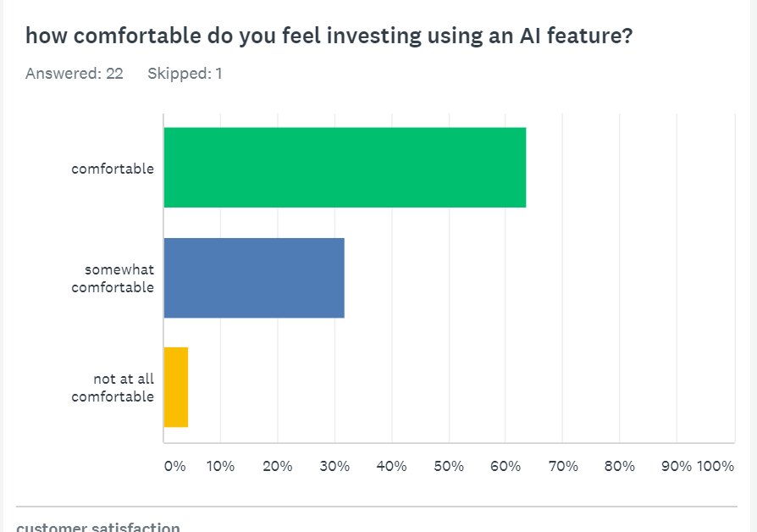
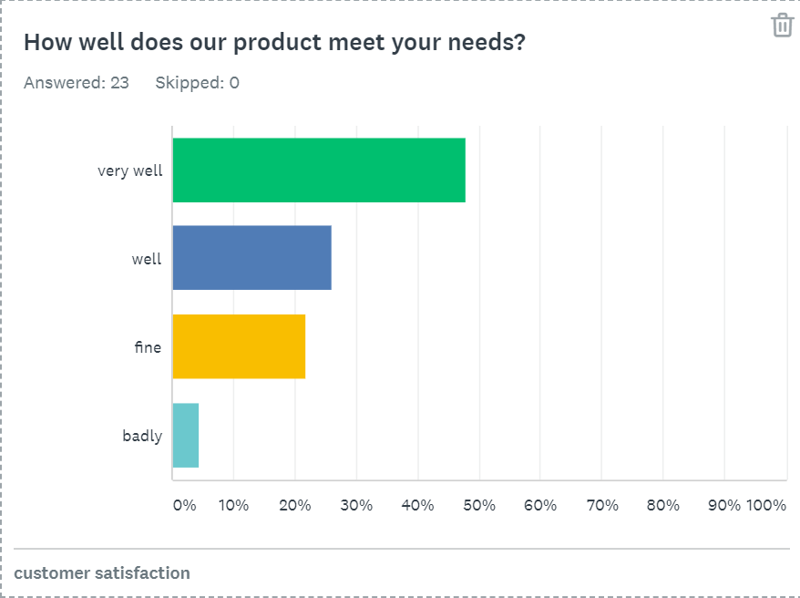
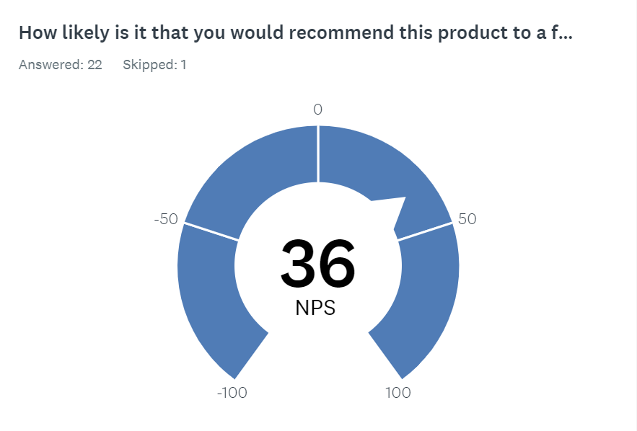
Email Survey

Slide 13
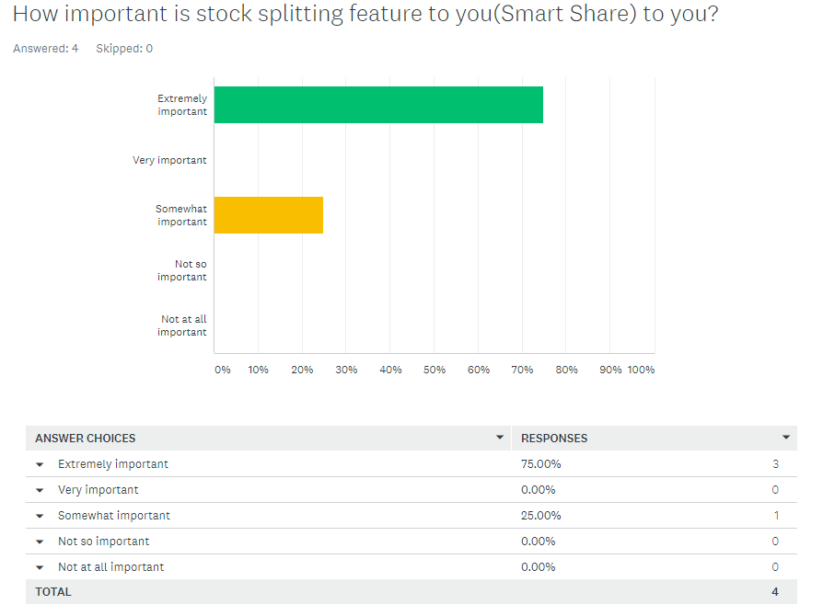
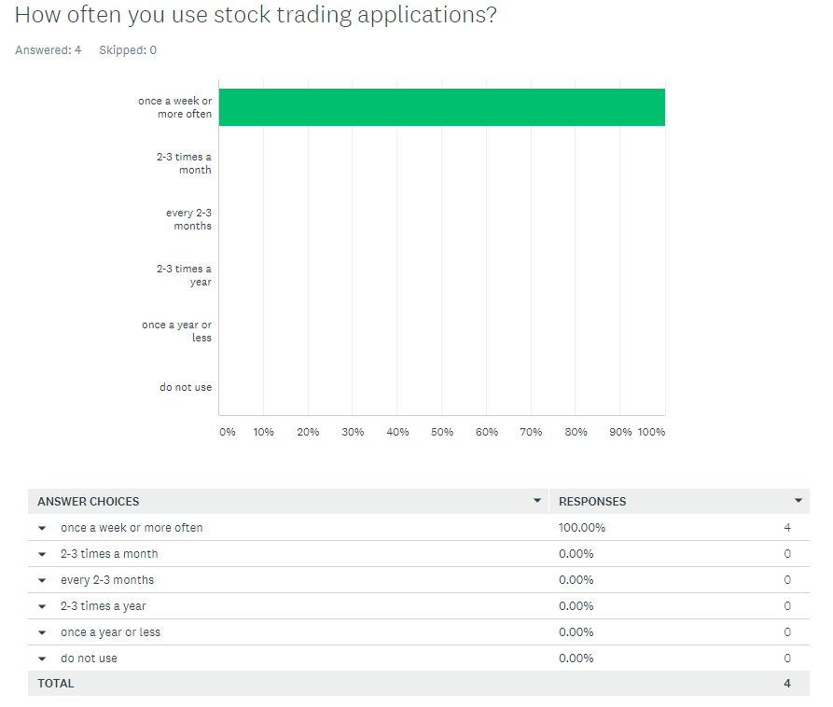
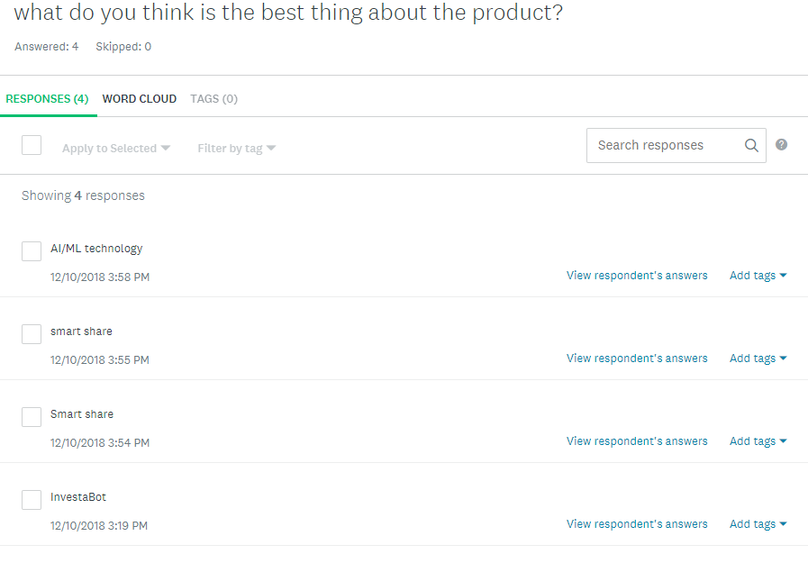
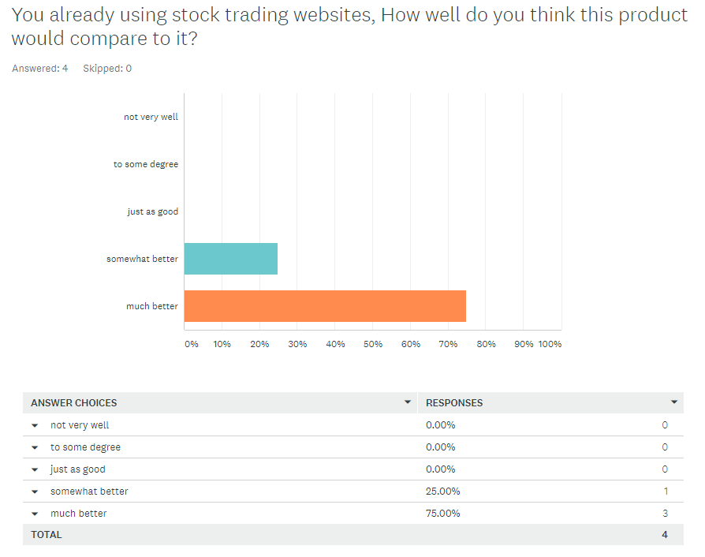
Concept Testing Survey

Slide 14
Usability Testing
Feature Name/Item to Test | No. of usability Testers | Task Completed?(Y/N) | Average time Taken(Minutes) | Comments/Obsercation | Observer
Login/Logout | 5 | Y | 3 | Secure | Komal
User Registration | 5 | Y | 4 | Easy Registration | Piyush
Navigation | 5 | Y | 12 | Meaningful Navigation | Kaustubh
Stock detail Screen | 5 | Y | 4 | Detailed information, good visualizations | Niravra
Validations | 5 | Y | 10 | Accurate | Parakh
Functionality | 5 | Y | 14 | Awesome Idea | Vishal

Slide 15
Usability Testing Analysis

Slide 16
Remote Usability testing
Feature Name/Item to Test | Task Completed?(Y/N) | Average time Taken(Minutes) | Comments/Obsercation | User
Login/Logout | Y | 3 | Authorized, Authenticate | John
User Registration | Y | 5 | Proper Information | Manav
Navigation | Y | 13 | Proper navigation Back and forth | Bhavesh
Stock detail Screen | Y | 5 | Meaning full information | Kranti
Validations | Y | 14 | Good work | Suraj
Functionality | Y | 16 | Great Concepts | Tom

Slide 17


Focus Group
Topic: Discuss about Stock Investment using ML/AI, Smart Share
Audience: Northeastern University graduate students
Venue: Curry Student Center
Questions:
What’s your thought about Machine Learning and Artificial Intelligence helping to invest in the Stocks?
Would you be interested to buy a stock in partnership with your friend?

Slide 18
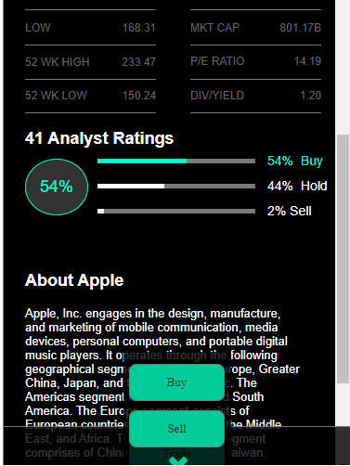
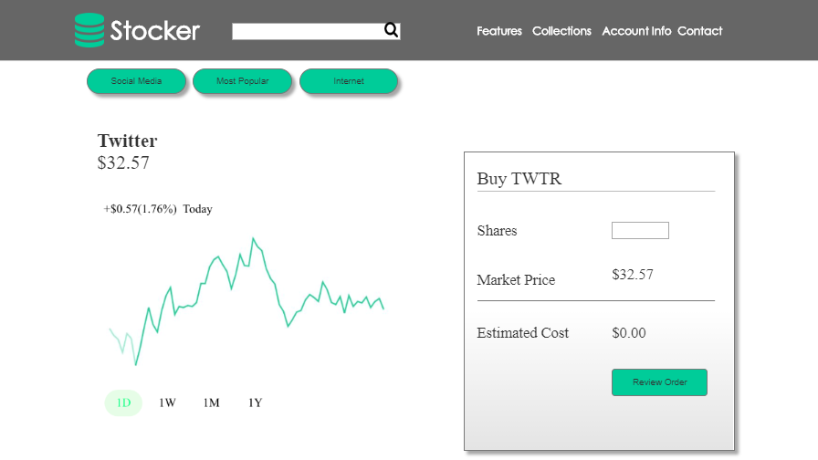
Google Material Design
Button Shadow
Layered Surface
Material Design Color

Slide 19
MPact
Business Objective:- Add a mobile app and website for all types of stocks at one place even for the user with minimum knowledge of stocks by implementing a AI/ML techniques.
Driver’s behind stockers:-
All stocks at one place
AI/ML techniques for best time to sell and buy stocks
Smart Share feature for users with limited investment
User Objective :- These days, you can buy stocks anywhere, anytime, as long as you’ve got a “smart device” and wifi using app like “STOCKERS” with its advanced feature like use of AI/ML .
Triggering Event/User Insights :-
Feelings :- How do users feel – in general and while interacting with the stockers app and website. Examples:- Excited, anxious, overwhelmed, nervous.
Thinking :- What knowledge, beliefs, and attitudes do users have while using stockers? Examples:- Should I trust AI/ML technologies?
Saying :- What questions does user have after using stockers? Examples:- What are the benefits of using Stockers? Should I invest more or less?
Doing :- How users interact with product across all the channels? What kind of actions do they take? Examples:- Planning to buy stocks using AI/ML

Slide 21
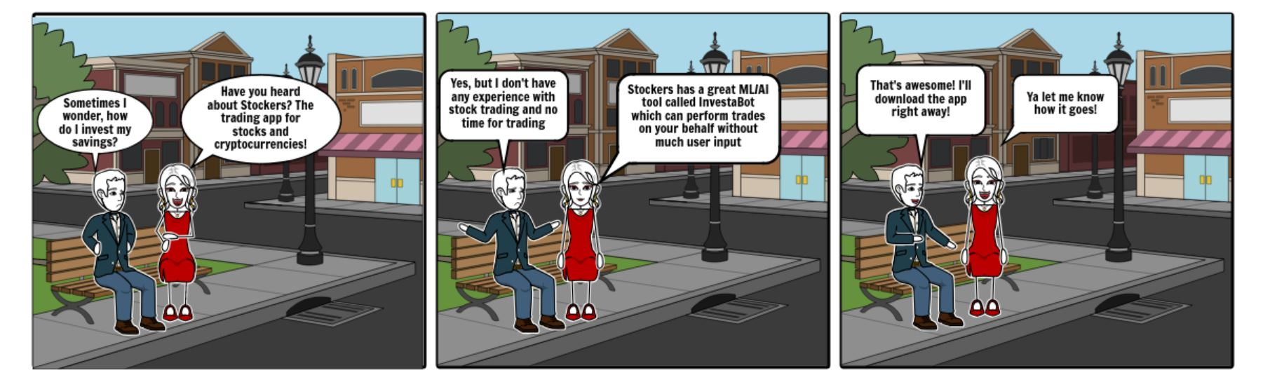
Story Board

Slide 22
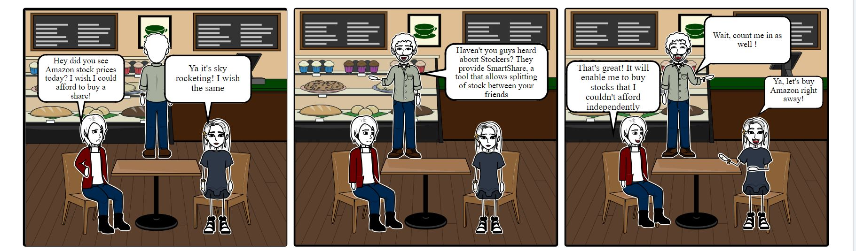
Story Board

Slide 23
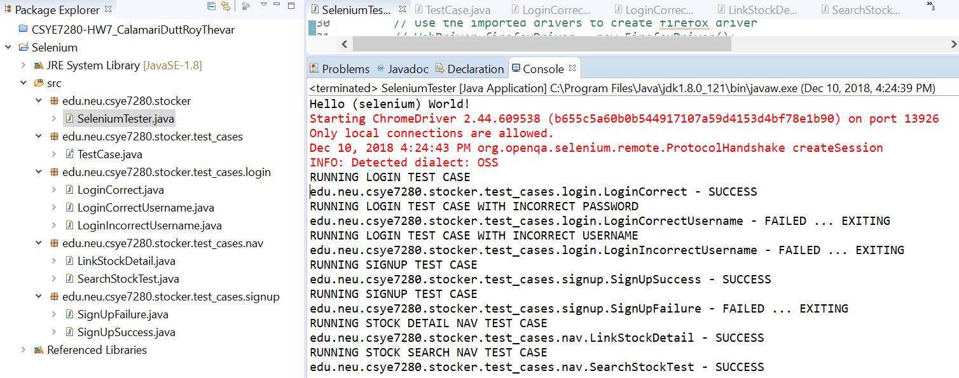
Quality Assurance
Tools used:
Selenium WebDriver

Slide 24
Thank You!

